Slide 1

Brainwaves 2019 ML Challenge
-RAJAT RANJAN
(Altered_Carbon)

Slide 2
Information Extraction from ISDA Legal Documents
Problem Statement
ISDA Documents with 40 clauses and about 200 fields that are to be extracted per document using Machine Learning Techniques. Whole document comprises of up to 40 clauses with up to 250 fields, however for hackathon we are considering 8 clauses which hold 29 essential fields
Objective
Providing ML solution for information extraction from ISDA documents
Continuous online improvement of models based on feedback
A generic platform to be used for other types legal documents

Slide 3
Approach
Extracting most suitable text corpus from the pdf/xml document using Clause search to feed into the Machine learning model.
Cleaning Train Data and Test Data for unnecessary noise.
Generating TF-ID and other features related to Text data based on the tagging with each most suitable information.
Validating accuracy

Slide 4
Approach
2 Approach
ML
Building a random forest classifier model and train the data to its labels
Predicting the said Test Data
Non-ML
Using text matching
Using NER for States and Town
Text scrapping based on context

Slide 5
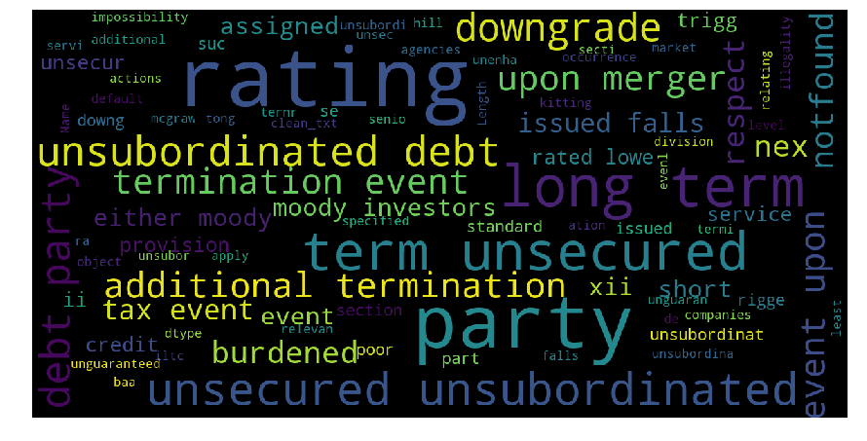

Slide 6
Challenges
Data not structured as in normal ML problems.
Data was not marked up properly due to OCR(dates were malformed and spelling mistakes).
Implementation a business case in such a short span of time along with understanding legal terms.
Too many attributes to extract, didn’t get time for any feature generation.

Slide 7
Pros and cons of my Approach
Pros
Easily scalable generic solution (manageable in few scripts)
Faster prediction/output time
Flexible to extract any additional information (attributes)
Training time is also minimal
Process is not resource extensive and works on minimum hardware
Cons
Cannot recognize OCR mistakes
Extracting Nouns may sometimes not fetch correct values

Slide 8
THANK YOU

